Slide 1

DATA POISONING OF AN INFORMATION SECURITY MACHINE LEARNING MODEL
UTD TEAM-2
MID-TERM PRESENTATION

Slide 2
TEAM MEMBERS
Rishi Dandu (Graduate Student) - rkd160030@utdallas.edu
Ravi Teja Avuthu (Graduate Student) - rxa210038@utdallas.edu
Harrison Hamric (Under-Graduate Student) - hgh160130@utdallas.edu
Payton Harmon (Under-Graduate Student) - pnh170000@utdallas.edu
Ashrafi Akbar (phd Student) - khandakarashrafi.akbar@utdallas.edu

Slide 3
Agenda
Introduction
Schedule
Progress
Previous Work
Results
Issues
Questions

Slide 4
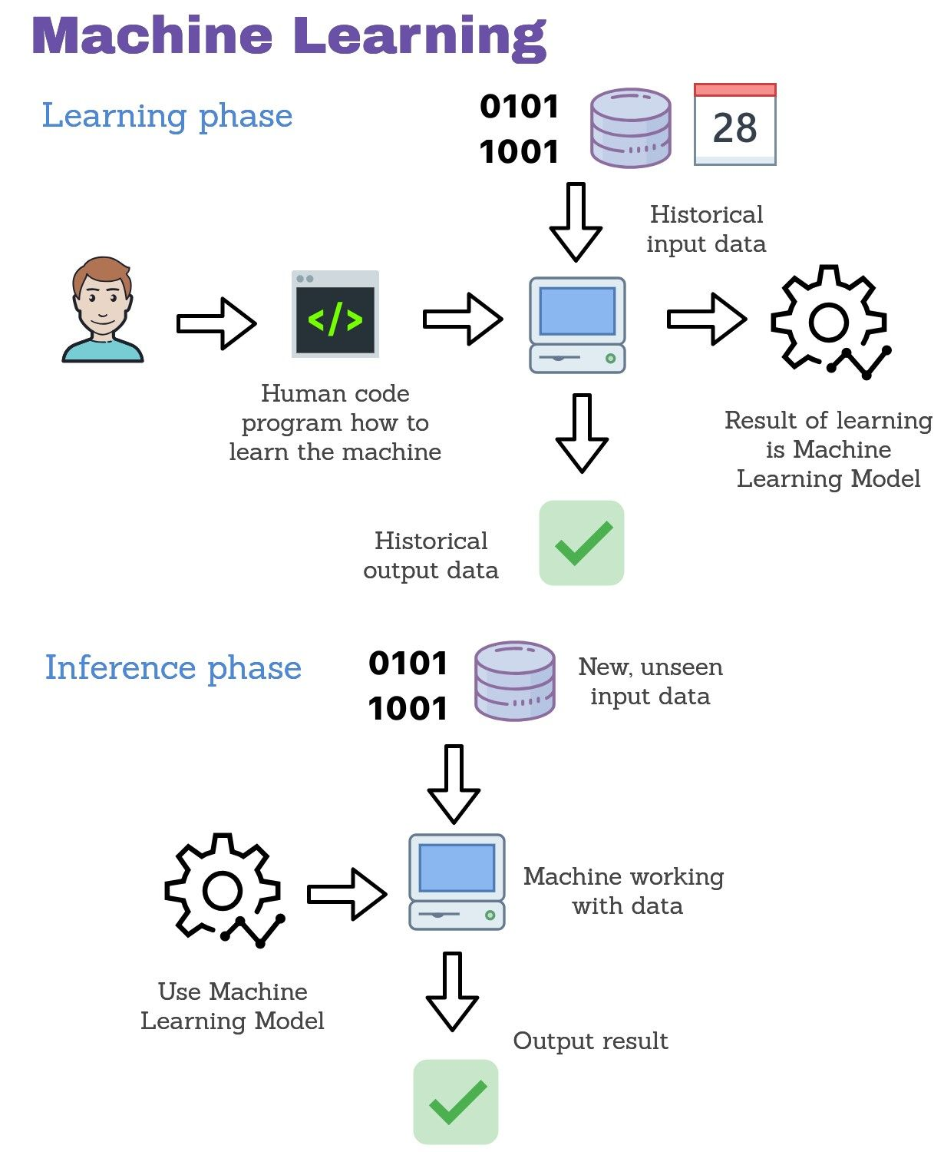
Introduction
Machine learning (ML) is the study of computer algorithms that can improve automatically through experience and by the use of data.
Machine Learning (ML) classifier is an algorithm that automatically orders or categorizes data into one or more classes.
Many of these detection systems boast impressive performance however…
ML systems often aren’t designed to be robust against adversarial attacks
  Data Poisoning Attacks
  Evasion Attacks
Goal: Identify feasible techniques to prevent data poisoning on the drebin
dataset and come up with paradigms to help prevent data poisoning attacks.

Slide 5
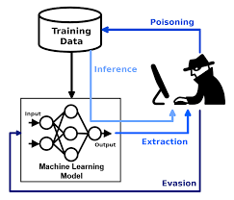
Introduction Cont.
Data Evasion
most common attack on machine learning model performed during inference.
A typical example is to change few pixels of image before uploading it to the model so that recognition system fails to classify the result.
Data Poisoning
The attacker can exploit the ML model by poisoning the data before sending the data to the model for training.
This results in impaired model which is trained on wrong train data and wrong classification of test data.

Slide 6
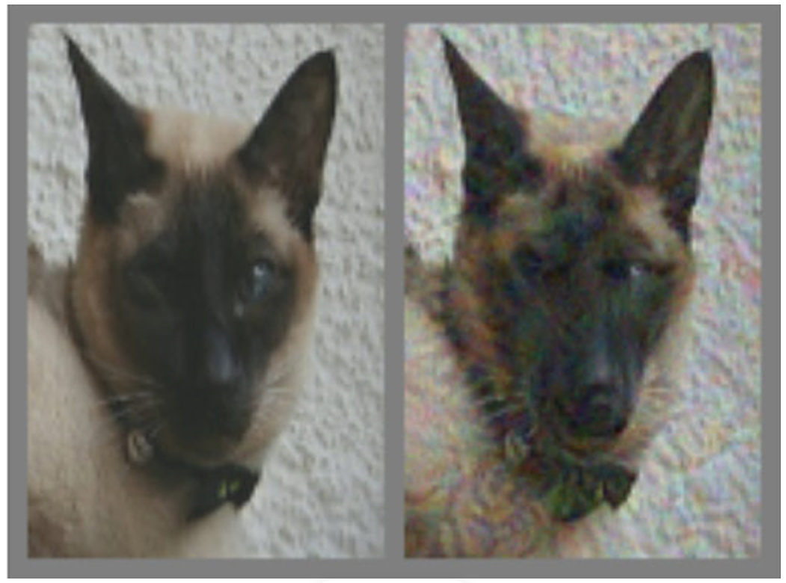
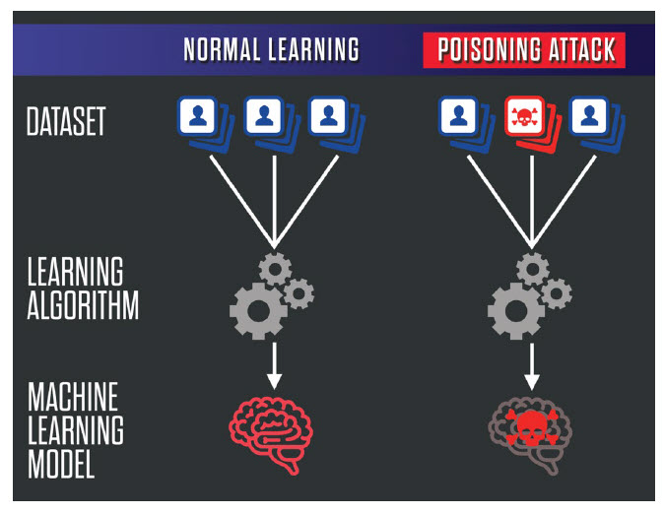
Introduction Cont.
Data Evasion
Data Poisoning
Modified image which looks like a cat
Proper image of a dog

Slide 7
Schedule
Understanding data poisoning
Poisoning a dataset
Understanding the parameters of the Drebin dataset
Identifying parameters that can be poisoned
Poisoning those parameters
Identify method to discover poisoning and mitigate damage
Summarize our research and deliver a digestible report
Phase 1 (Complete) | Phase 2 (In Progress) | Phase 3
Understanding poisoning, finding parameters to poison | Poisoning parameters and dataset | Identify methods to discover poisoning Summarize research
Notes:
Obtain understanding of data poisoning techniques and fundamentals
Apply techniques to kaggle dataset
Understand parameters of drebin dataset
Identify weaknesses in the dataset
Try to poison the drebin dataset
Take our learning and identify prevention to known poisoning attacks
Previous slide ^
We wanted to have a good idea about what our plan was from the beginning, and create a schedule we could follow. So this shows our progress and timeline for the work done so far.
We have completed work on understanding data poisoning, simple datasets, learning from that the parameters to target, and then methods to target those parameters
We are still in progress for that last bit
We are looking forward to identifying ways in which we can prevent this happening to other models and datasets
And eventually we will summarize our research in a report

Slide 8
Previous Work
Rosenberg, Ishai, et al. "Adversarial machine learning attacks and defense methods in the cyber security domain." ACM Computing Surveys (CSUR) 54.5 (2021): 1-36.
  Lists machine learning attacks and defenses.
Severi, Giorgio, et al. "{Explanation-Guided} Backdoor Poisoning Attacks Against Malware Classifiers." 30th USENIX Security Symposium (USENIX Security 21). 2021.
  Demonstrates specific attack on machine learning models.
Mehra, Akshay, et al. "How robust are randomized smoothing based defenses to data poisoning?." Proceedings of the IEEE/CVF Conference on Computer Vision and Pattern Recognition. 2021.
  Randomized smoothing defense technique.
Shapley, Lloyd S. "Notes on the n-Person Game—II: The Value of an n-Person Game.(1951)." (1951).
Notes:
Before we could do our own research we had to get a background of previous work done in our topic.
Rosenberg et. al
compiles the latest list of possible attacks against machine learning algorithms and
possible defenses
For example it goes through blackbox based attacks for facial recognition and
fingerprinting and also adversarial attacks to generate fake data.
Severio Giogio et. al.
goes through effective attacks on ML models specifically using PDFs and PeX files as
inputs.
goes through effective ways on how to disguise malicious code in a format
where the models are not able to easily recognize the features and think it is a harmless file.
goes through ways of defending against such attacks
Mehra, Aksahy et al
focuses on defense and goes through the randomized smoothing
technique.
this technique makes it a harder to poison data
It isn’t poison proof
They were able to poison a dataset with imperceptible changes.
4.
looked at the concept of a shapley value as introduced by Lloyd Shapley.
A shapley value is used in machine learning to help identify the contribution an individual feature has towards the model.
our project mainly attempts to test these ideas on real datasets of malicious software. Our
project will clarify the real threat that adversaries can have by poisoning datasets that are in use
by actors that identify malicious software.

Slide 9
Progress
Developed understanding of Data Evasion vs Data Poisoning and the various related issues along with SHAP values and explainable AI fundamentals
Acquired and investigated the Android drebin dataset
Found pre-existing data poisoning libraries(SecML) that we are applying to the Android(drebin) dataset
Generated adversarial examples to confuse SVM classifier (Data Evasion)
In the process of finding effective features to poison to reduce accuracy of classifier

Slide 10
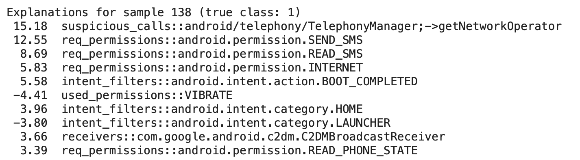
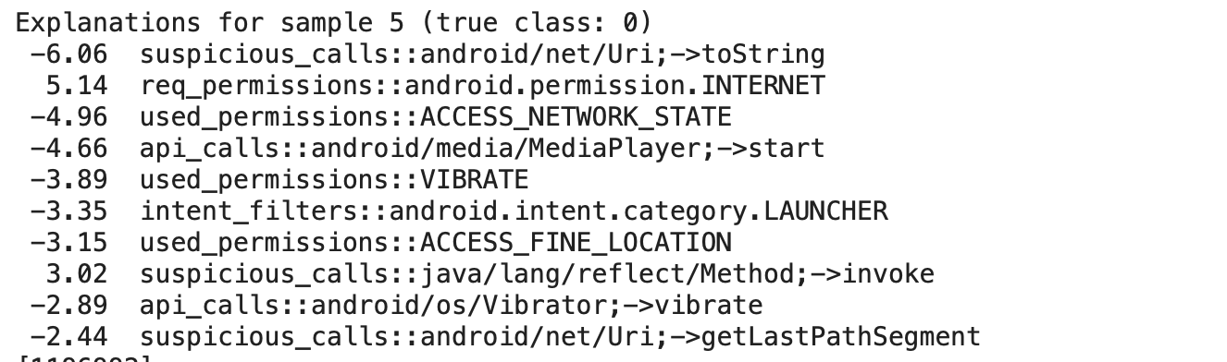
Results

Slide 11
Issues
Concepts initially took a little time to understand
Had issues working with the existing data structures of secML and how to use them with sci-kit learn
Difficult to work with sparse matrix as it is hard to visually see the features

Slide 12
Summary and Next Steps
Data Poisoning vs Data Evasion
Looked at Feature Selection methods
Researched previous work on specific attacks
Used existing libraries to perform Data Evasion attacks on the drebin dataset
Currently trying to poison data to reduce accuracy
Try to identify techniques to prevent these type of attacks

Slide 13
Questions

